Slide 1
DMA(Direct Memory Access)
Need For DMA
Avoid Using General-purpose processor
Programmed I/O (pio)
DMA controller
Direct data transaction b/w I/O device and Memory
Host write DMA Command block
Address Pointer to Source & Destination Address
Count
Handshaking b/w DMA controller and device controller
DMA-request
DMA-Ack
CPU relinquishes BUS control
Cycle Stealing (CPU HOLD , HOLDA)

Slide 2
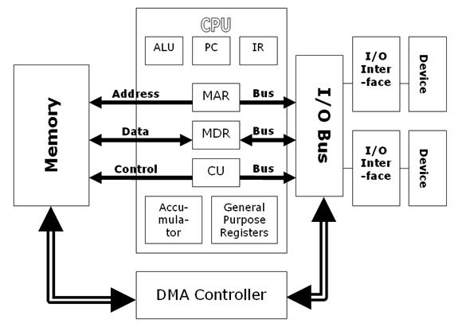
DMA Working

Slide 3
DMA Transfer Process

Slide 4
Application I/O Interface
Provide User application access to a wide variety of different devices.
Abstraction , Encapsulation and software layering- Ensures Implementation independence.
Standardized set of functions-Interface
Device-driver layer hides differences among I/O controllers from kernel

Slide 5
Various Device Dimensions
Character-stream or block
Sequential or random-access
Synchronous or asynchronous (or both)
Sharable or dedicated
Speed of operation
Read-Write, read only, or write only

Slide 6
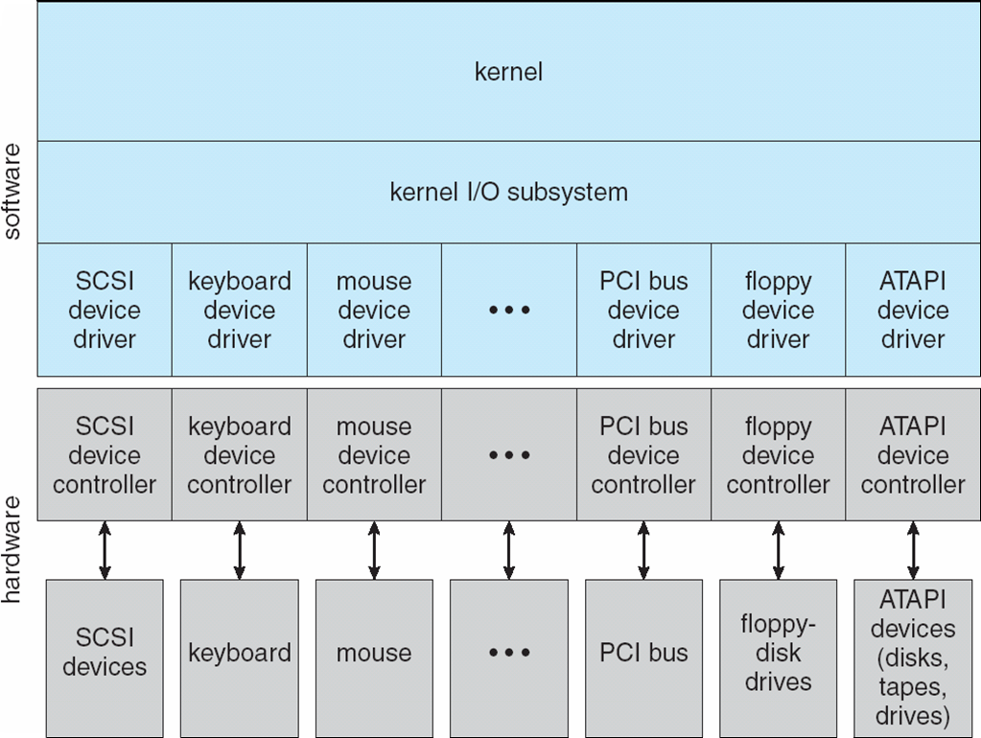
Kernel I/O Structure

Slide 7
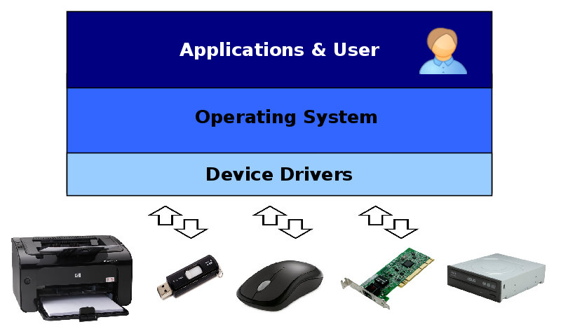
Simplified I/O Structure

Slide 8
I/O Device Classification
Broadly I/O devices can be grouped by the OS into
Block I/O
Character I/O (Stream)
Memory-mapped file access
Network sockets
For direct manipulation of I/O device specific characteristics, usually an escape / back door
UNIX ioctl() [I/O control]
3 parameters: File Descripter,Driver Command select, arbitrary Data Structure

Slide 9
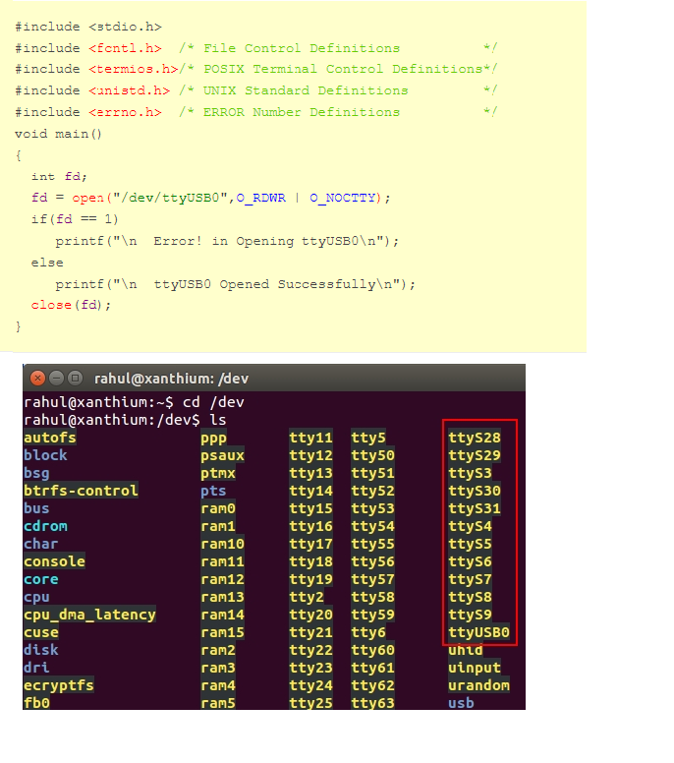
Linux Dev Files

Slide 10
Block and Character Devices
Block devices
Commands present :read, write, seek(Random access)
Raw I/O, direct I/O(w/o lock & buffering)
Memory-mapped file access can be layered
File mapped to virtual memory(Demand Paging)
Eg : Hard Drives
Character devices
Commands present: get(), put()
Eg: keyboards, mice, serial ports

Slide 11
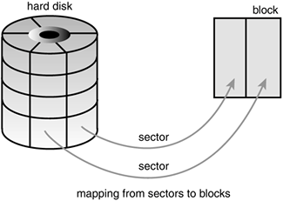
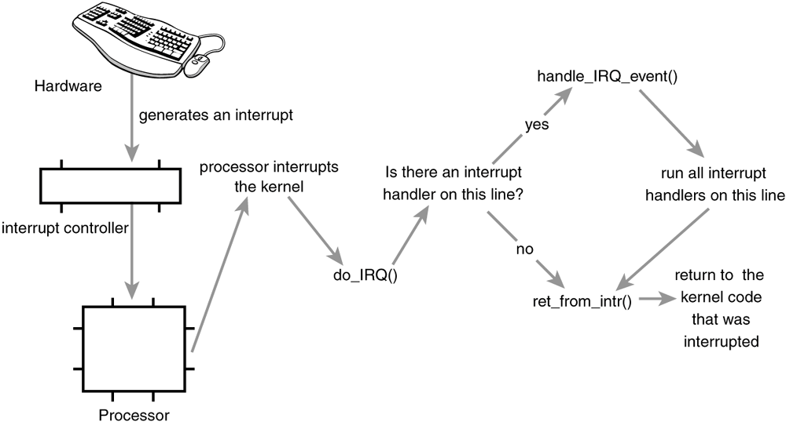
Block Device
Character Device

Slide 12
Network Device
Different from Block/character Devices
Provides Network SOCKET interface
Server Implementation: select()
UNIX provides pipes, FIFOs, streams, queues,sockets

Slide 13
Clocks and Timers
Provides Current Time, elapsed Time , Set timer
Programmable interval timer used for generating periodic interrupts
Uses: Scheduling time-sliced preemptions , flush dirty cache buffers to disks, cancel operations during N/W congestions
Generally 18 to 60 ticks per second
Hardware clock constructed from High Frequency counter
Eg:8155 timer (14bit counter & 2bit mode selection)

Slide 14
Blocking and Non-Blocking I/O
Blocking: Execution of process Suspended
Moved from Run to wait queue
Resumes after I/O completion
Asynchronous(varying time)
Easier
Non Blocking: Calling process is not halted
Eg: Keyboard , Mouse
Returns count of bytes transferred
Asynchronous Call: Returns immediately, I/O communicates after completion
Difference b/w Non-blocking & Asynchronous :read()

Slide 15
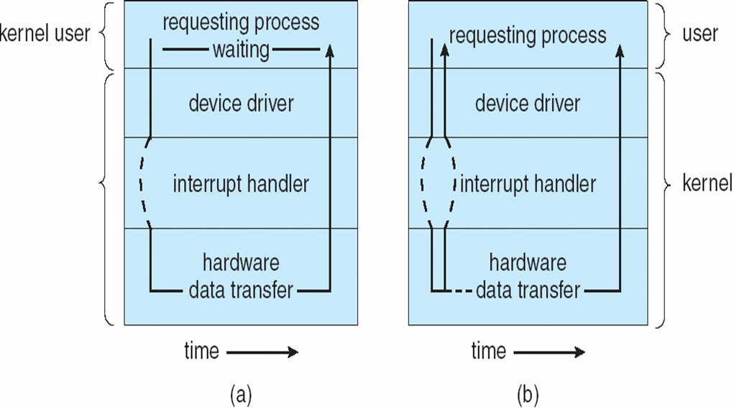
I/O Methods
Synchronous
Asynchronous

Slide 16
Kernel I/O subsystem
Provides services related to I/O
Scheduling
Buffering
Caching
Spooling
Device Reservation
Error Handling
Responsible for self protection

Slide 17
I/O Scheduling
Determine a good I/O order
Increase System performance
Wait request queue for each device
For Asynchronous I/O support , device-status table is used

Slide 18
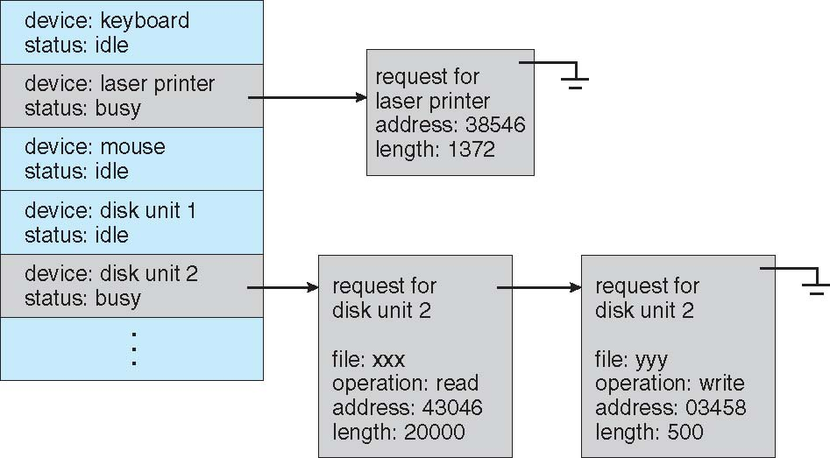
Device-status Table

Slide 19
Buffering
Temporary space to store data
Mainly 3 use:
Speed Mismatch
Double Buffering
Data Size Mismatch
Copy Semantics

Slide 20
Caching
Fast memory region that holds copies of data
Cache and Buffer are different
A memory can be used for both:
Buffer disk data For I/O scheduling
Use same buffer used as cache for shared files

Slide 21
Spooling and Device Reservation
Buffer ;holds O/P for devices that can’t be interleaved
Spool files and queues are used ; eg : Printer
Another solution is to provide exclusive access
Idle device allocated or de-allocated
Deadlock has to be prevented

Slide 22
Error Handling
OS can recover from disk read, device unavailable, transient write failures
Read() failure results in read() retry
Send() “ “ “ “ resend()
Permanent failure like , disk controller failure :generally unrecoverable
I/O system calls return 1 bit info.
UNIX additionally used errno

Slide 23
I/O Protection
Accidental/Purposeful use of illegal I/O instr
I/O instr are defined privileged
System calls initiate I/O operations
Memory-mapped and I/O port memory locations must be protected

Slide 24
Use of a System Call to Perform I/O

